Slide 1
Working with Streams – In Depth

Slide 2

Overview
Generating and building streams
Reduction and collection in detail Grouping and partitioning Parallel streams
Specialized streams

Slide 3
Generating and Building Streams

Slide 4
Reducing Streams in Detail

Slide 5
Collecting Streams in Detail

Slide 6
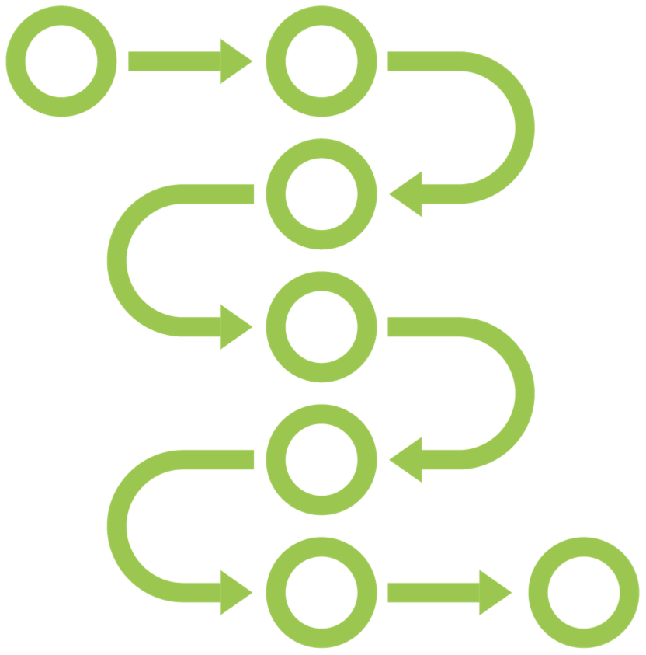

Collecting Streams
Collection = Mutable reduction
A collection operation reduces a stream into a mutable result container
Stream
ArrayList

Slide 7

Collecting Streams
<R> R collect(Supplier<R> supplier, BiConsumer<R, ? super T> accumulator, BiConsumer<R, R> combiner)
Supplier
Accumulator
creates
Combiner

Slide 8
Collection and Reduction
Mutable reduction
<R> R collect(Supplier<R> supplier, BiConsumer<R, ? super T> accumulator, BiConsumer<R, R> combiner)
Immutable reduction
<U> U reduce(U identity, BiFunction<U, ? super T, U> accumulator, BinaryOperator<U> combiner)

Slide 9
Collection and Reduction
collect(...)
reduce(...)
Accumulator
BiConsumer
BiFunction
R, T
U, T
U
Combiner
BiConsumer
BinaryOperator
R, R
U, U
U

Slide 10
Working with Collectors

Slide 11

Collector Functions
Stream
Collector
Supplier
Accumulator
Combiner
Finisher
Result

Slide 12
Working with Collectors
<R, A> R collect(Collector<? super T, A, R> collector)
Collectors
toList() toSet() toMap()
...

Slide 13
Grouping Stream Elements

Slide 14



Grouping Stream Elements
Stream
collect
groupingBy
collect
collect

Slide 15
Partitioning Stream Elements

Slide 16
Parallel Streams

Slide 17
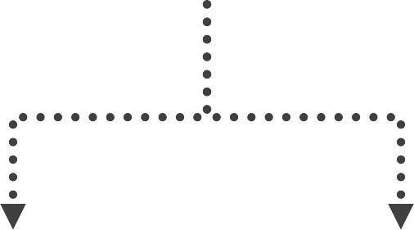

Parallel Streams
Stream

Slide 18
Creating a Parallel Stream
List<String> names = products.parallelStream()
.filter(product -> product.getCategory() == Category.FOOD)
.map(Product::getName)
.collect(Collectors.toList());
List<String> names = products.stream()
.filter(product -> product.getCategory() == Category.FOOD)
.map(Product::getName)
.collect(Collectors.toList());

Slide 19
Internal vs External Iteration
External iteration
for (int i = 0; i < products.size(); i++) { Product p = products.get(i); System.out.println(product);
}
Internal iteration
products.parallelStream()
.forEach(System.out::println);
products.stream()
.forEach(System.out::println);

Slide 20
Not a Magic Solution
Thread management and communication overhead
Only likely to be beneficial when limited by CPU
Measure if it is benificial for your use case

Slide 21
Grouping-By in Parallel Streams
Map<Category, List<Product>> productsByCategory = products.stream().collect(
Collectors.groupingBy(Product::getCategory));
Map<Category, List<Product>> productsByCategory = products.parallelStream().collect(
Collectors.groupingByConcurrent(Product::getCategory));

Slide 22
Specialized Streams

Slide 23
Specialized Standard Functional Interfaces
XFunction<R>
XPredicate
XToYFunction
XConsumer
ToXFunction<T>
ObjXConsumer<T>
ToXBiFunction<T,U>
XSupplier
XUnaryOperator
XBinaryOperator
X, Y = Int, Long, Double
Extra: BooleanSupplier

Slide 24
Specialized Streams
IntStream
LongStream
DoubleStream

Slide 25
Course Summary

Slide 26
Working with Lambda Expressions
A lambda expression is an anonymous method
A lambda expression implements a functional interface
A functional interface has a single abstract method

Slide 27
Working with Lambda Expressions
Lambda Expression Syntax
(parameters) -> { body }
Capturing Variables
BigDecimal priceLimit = new BigDecimal(“5.00”); Predicate<Product> isCheap =
product -> product.getPrice().compareTo(priceLimit) < 0;
The meaning of “this” and “super” in a lambda expression
Working with checked exceptions in a lambda expression

Slide 28
Method References
Use a method reference instead of a lambda expression
A method reference implements a functional interface
Refers to a static or non-static method or a constructor

Slide 29
Functional Interfaces
@FunctionalInterface interface ProductFilter {
boolean test(Product product);
}

Slide 30
Common Standard Functional Interfaces
T
Function
R
T, U
BiFunction
R
T
Consumer
T, U
BiConsumer
Supplier
T
T
Predicate
boolean
T, U
BiPredicate
boolean
T
UnaryOperator
T
T, T
BinaryOperator
T

Slide 31
Specialized Standard Functional Interfaces
XFunction<R>
XPredicate
XToYFunction
XConsumer
ToXFunction<T>
ObjXConsumer<T>
ToXBiFunction<T,U>
XSupplier
XUnaryOperator
XBinaryOperator
X, Y = Int, Long, Double
Extra: BooleanSupplier

Slide 32
Working with Streams – The Basics
products.stream()
Intermediate operations
.filter(product -> product.getCategory() == Category.FOOD)
.map(Product::getName)
Terminal operation
.forEach(System.out::println);
Stream processing is lazy

Slide 33
Differences between Streams and Collections
Collection Stores elements in a data structure
Eager evaluation
Imperative programming Do modify the collection
Can be iterated multiple times
Never infinite
Stream
Does not store elements
Lazy evaluation
Functional programming Does not modify its source
Iterating consumes the stream May be infinite

Slide 34
Stream Operations
Searching
Filtering and Transforming
findFirst() findAny() anyMatch() allMatch() noneMatch()
filter() map() flatMap()
Reducing and Collecting
collect(Collectors.toList()) collect(Collectors.joining())

Slide 35
Reducing and Collecting in Detail
reduce()
Immutable reduction
collect()
Mutable reduction

Slide 36
Collector Functions
Stream
Collector
Supplier
Accumulator
Combiner
Finisher
Result

Slide 37
Grouping Stream Elements
Stream
collect
groupingBy
collect
collect

Slide 38
Partitioning Stream Elements
Stream
true
collect
partitioningBy
false
collect

Slide 39
Parallel Streams
Stream

Slide 40
Specialized Streams
IntStream
LongStream
DoubleStream

Slide 41
Method References
Lambda Expressions
Functional Interfaces
Streams
Stream Operations
Reduction and Collection
Collectors
Grouping and Partitioning
Parallel Streams

